Slide 1
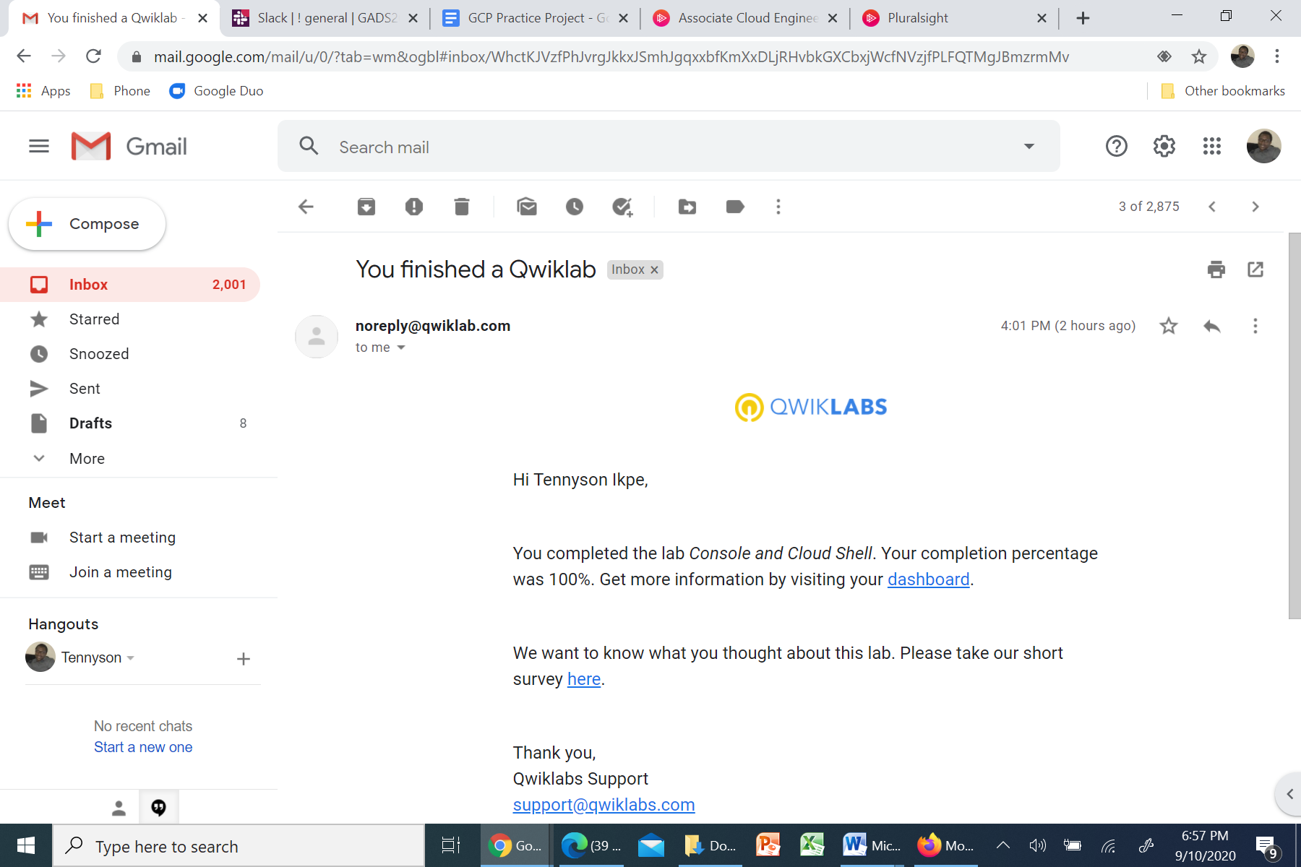

Slide 2
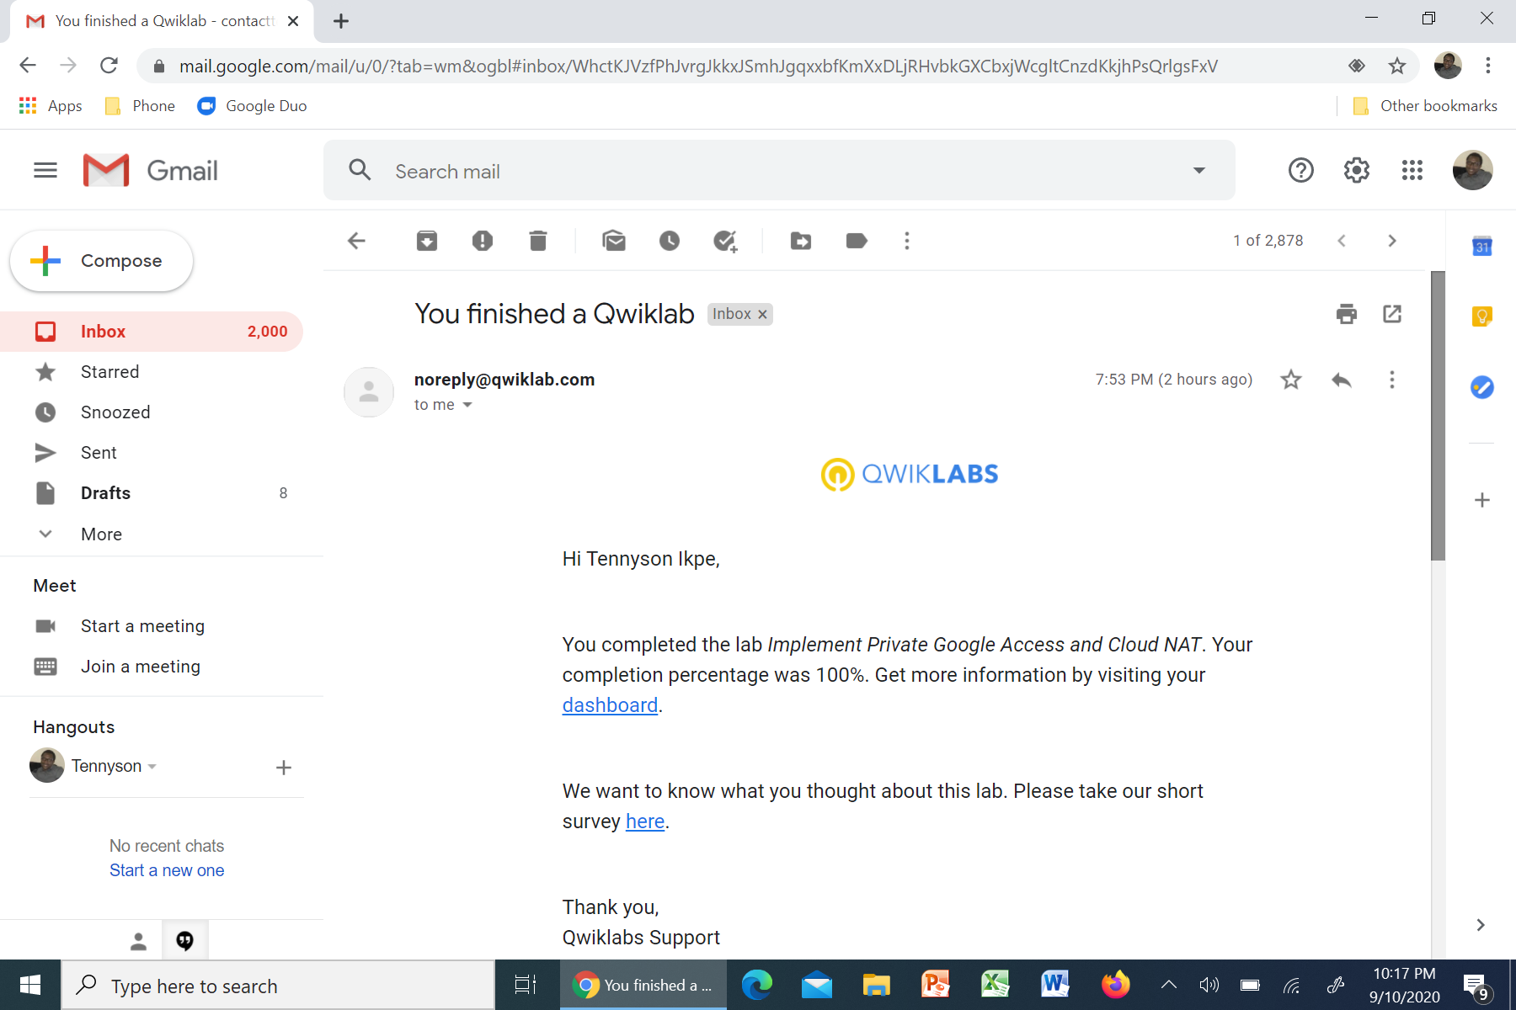

Slide 3


Slide 4
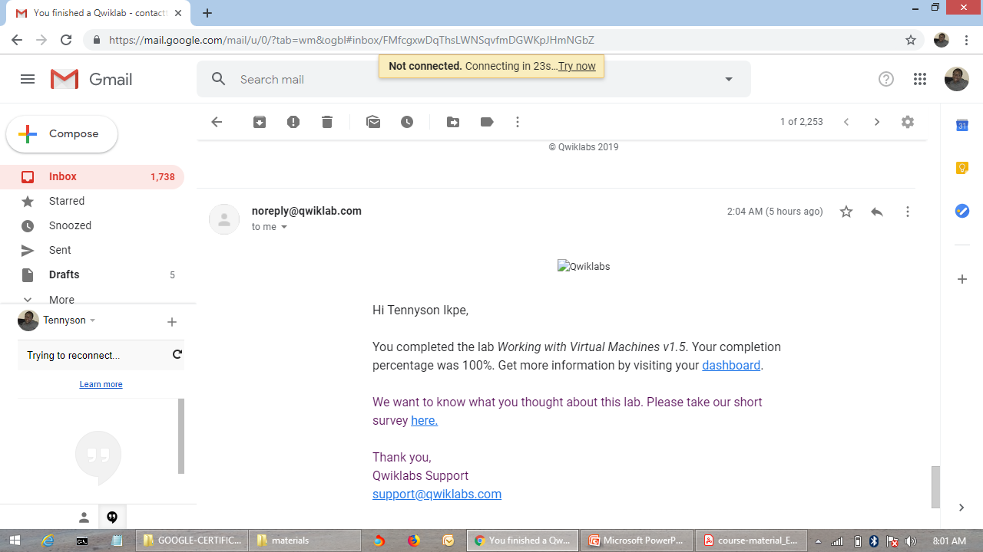
Lab: Working with Virtual Machines

Slide 5

Lab: Creating Virtual Machines

Slide 6
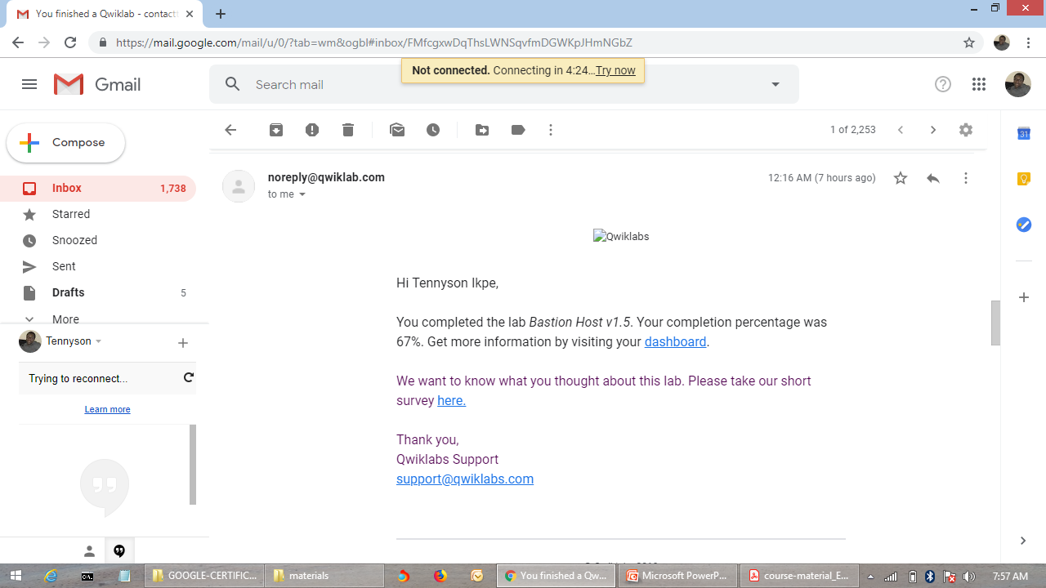
Lab: Bastion Host

Slide 7
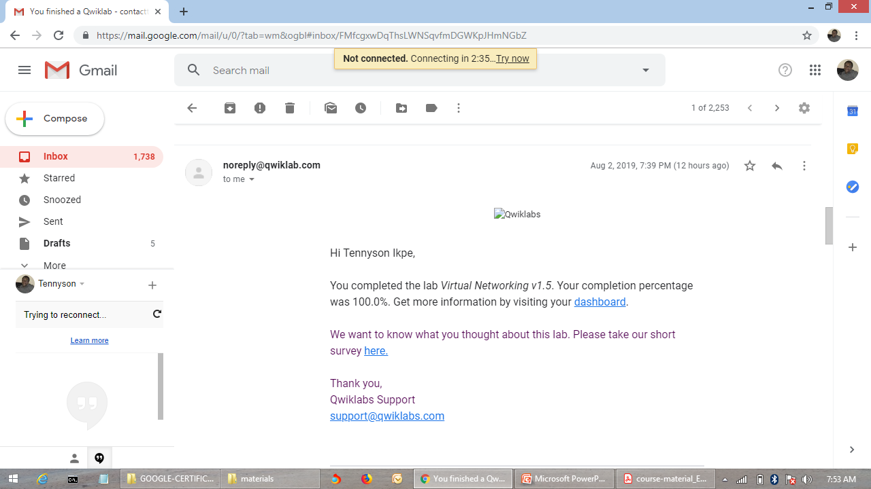
Lab: Virtual Networking

Slide 8
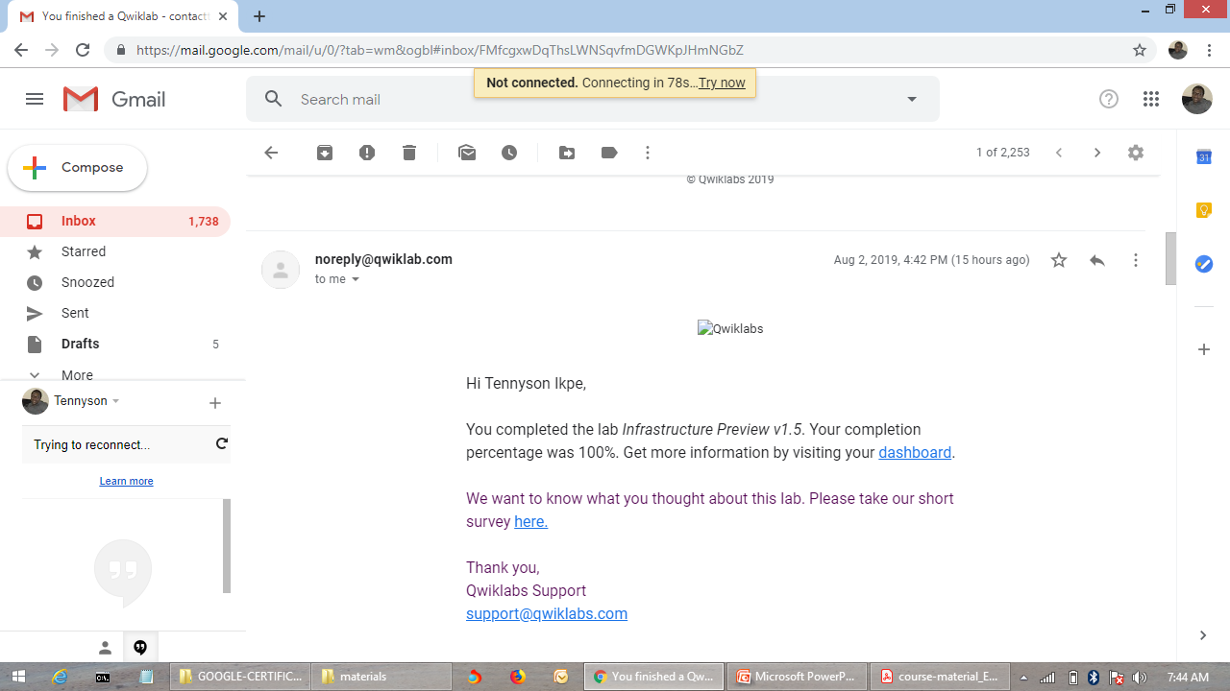
Lab: Infrastructure Preview

Slide 9

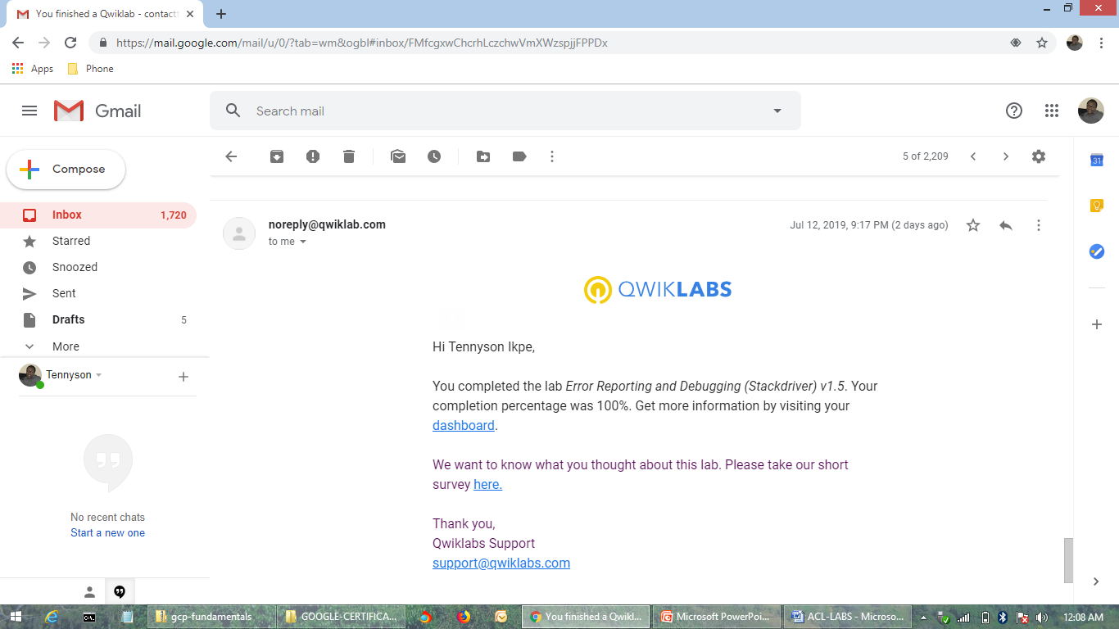
ECI LAB: Error Reporting and Debugging with Stackdriver

Slide 10

ECI LAB: Resource Monitoring with Stackdriver

Slide 11
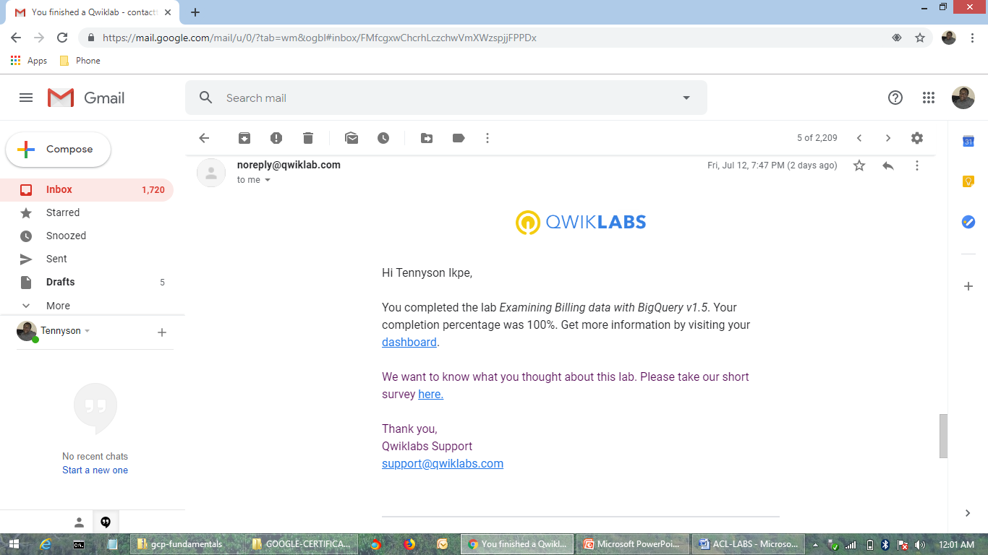
ECI LAB: Examining Billing Data with BigQuery

Slide 12
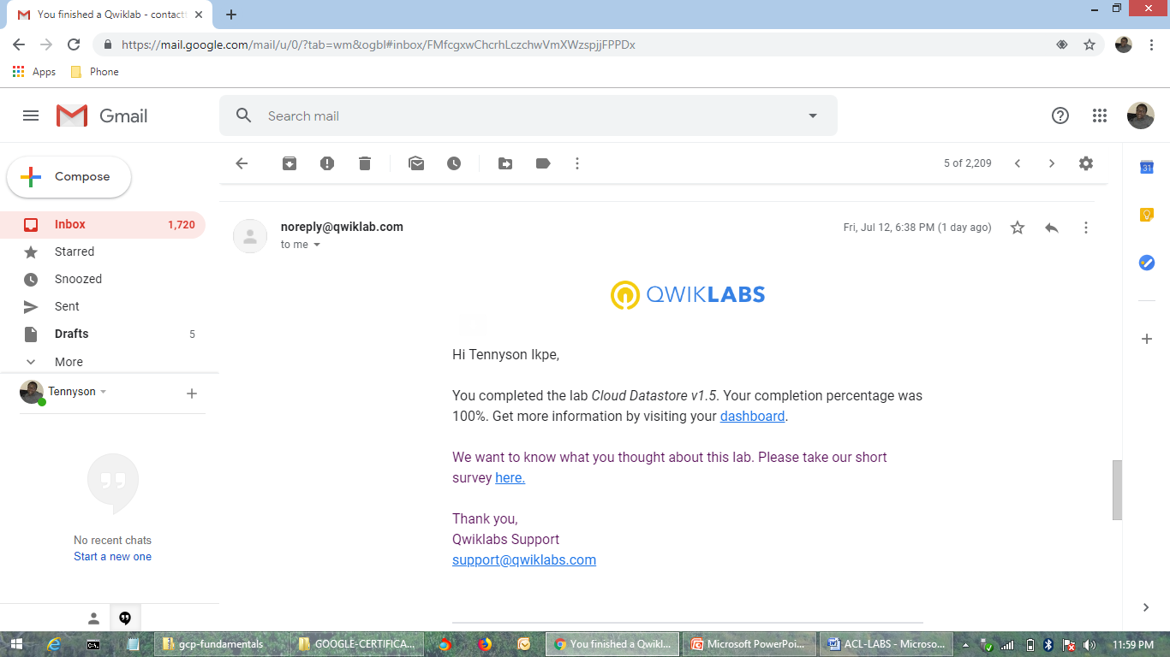
ECI LAB: DataStore

Slide 13

ECI LAB: Cloud SQL

Slide 14

ECI LAB: Cloud Storage

Slide 15
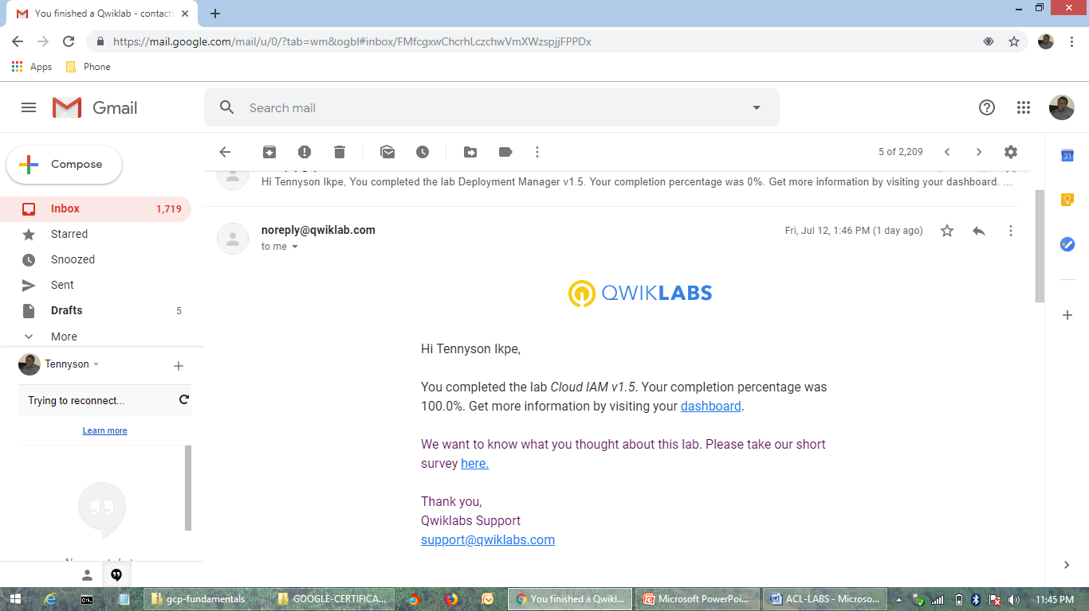
ECI LAB: Cloud IAM

Slide 16

ECI LAB: Deployment Manager

Slide 17
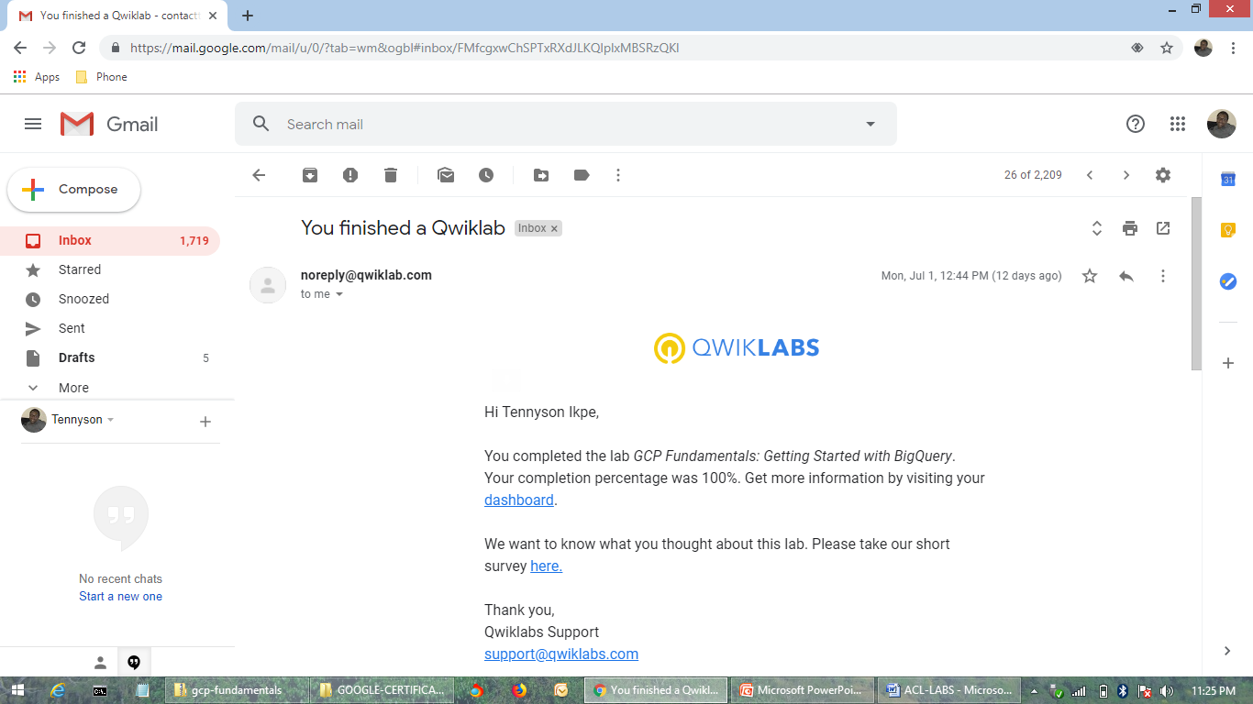
Getting Started with BigQuery

Slide 18
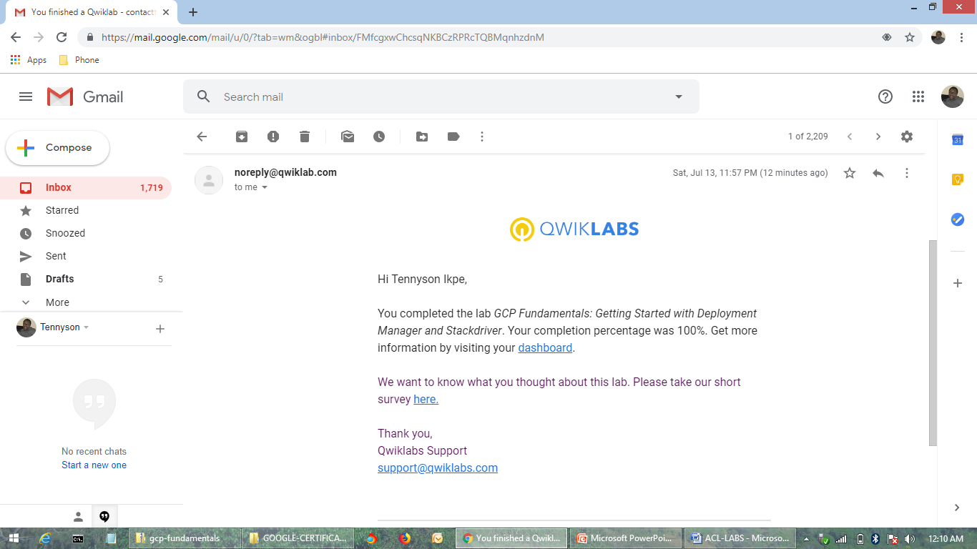
Getting Started with Deployment Manager and Stackdriver

Slide 19
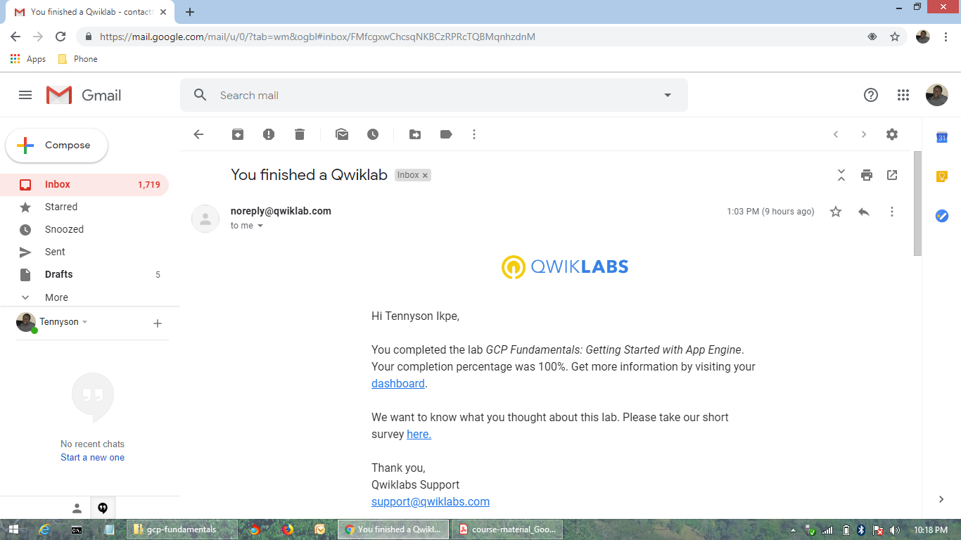
Getting Started with App Engine

Slide 20
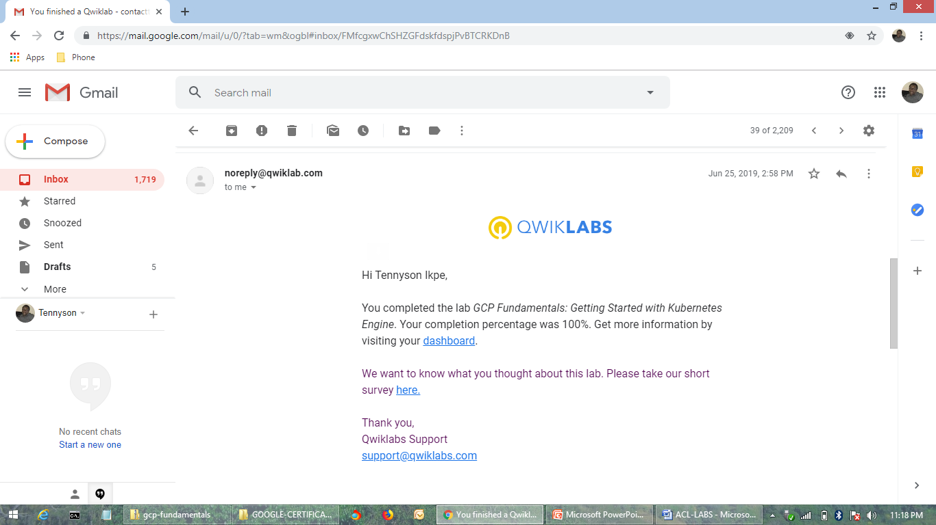
Getting Started with Kubernetes Engine

Slide 21
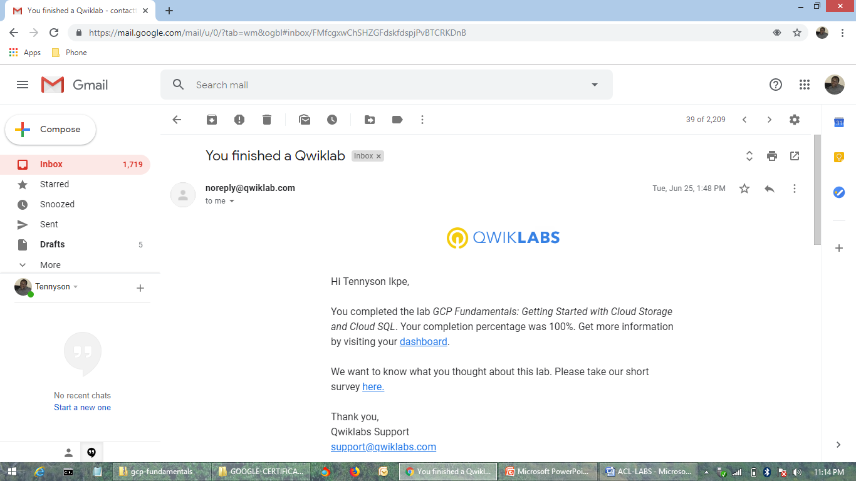
Getting Started with Cloud Storage and Cloud SQL

